Slide 1
Churn Rate Recovery and Loss Mitigation
Introduce the purpose of the analysis – leveraging customer data for informed decision-making and addressing business challenges.

Slide 2
Agenda
INTRODUCTION Slide 1
Financial Impact Slide 2
Churn Rate Analysis Slide 3
Session Insights Slide 4
Transaction Completion Slide 5
Churn Recovery Strategies Slide 6
Retention Incentives Slide 7
Loss Mitigation Slide 8
Actionable Insights Slide 9
Conclusion Slide 10

Slide 3
Introduction
Churn Rate Recovery and Loss Mitigation
Welcome & Introduction:
Purpose Introduction: Welcome to the "Churn Rate Recovery and Loss Mitigation" dashboard, crafted to empower our organization in the proactive management of customer churn. The primary purpose of this dashboard is to delve into churn patterns, enabling us to take informed and strategic measures for recovery..
Importance Emphasis: Understanding and addressing churn is not merely a task; it's a pivotal strategy for the overall health and sustainability of our business. Churn, the departure of customers, can significantly impact revenue streams, customer loyalty, and the brand's reputation. This dashboard equips us with the insights needed to navigate through this challenge effectively.
Financial Impact Highlight: Before we embark on the journey of analyzing churn patterns, let's underscore the financial significance of reducing churn. Every retained customer contributes to our revenue stability and growth. As we reduce churn, we are not just preserving existing revenue; we are unlocking the potential for increased profitability and long-term customer relationships. This sets the stage for the subsequent analyses that will help us delve deeper into the dynamics of customer engagement and transactions.

Slide 4
Financial Impact

Slide 5
Financial Impact
KPI Display: On this slide, we shine a spotlight on the tangible financial impact of reducing churn. A key performance indicator (KPI) indicator or a visually compelling bar chart takes center stage, showcasing the potential revenue gain achievable through effective churn reduction strategies..
Explanation: Let's delve into why this KPI matters. Reducing churn is not merely a theoretical goal; it directly contributes to the financial health of our organization. The potential revenue gain displayed on this chart represents more than just numbers; it encapsulates the real, monetary benefit we stand to gain by retaining customers.
In simple terms, for every customer retained, we retain their contribution to our revenue streams. Moreover, as we successfully reduce churn, we open avenues for increased profitability. Preserving existing revenue and fostering long-term customer relationships are pivotal elements of sustainable financial growth.
This chart serves as a visual affirmation of the correlation between churn reduction and financial prosperity. As we move forward in our analysis, remember that each retained customer is not just a statistic; they are a catalyst for our organization's continued success

Slide 7
Churn Rate Analysis
“Business opportunities are like buses. There's always another one coming.”

Slide 8
Churn Rate Analysis
Overall Churn Trends: In this section, we delve into the broader patterns of churn. A line chart takes center stage, illustrating the overall churn rate trends over a specific timeframe. This chart provides a comprehensive view of how churn has evolved over time, offering insights into general trends and potential seasonality.
Segment Breakdown: Understanding that not all customers are the same, we break down the churn rate further by different segments. To achieve this, a dual-axis line chart is employed. This allows us to compare and contrast churn rates among distinct segments, such as app users and website users.
Insights Discussion: Moving beyond the visual representation, let's discuss the insights derived from our analysis. By examining the overall churn trends, we can pinpoint periods of notable churn spikes or dips. This information is crucial for identifying potential factors influencing customer behavior.
Additionally, the segment breakdown sheds light on variations in churn rates across different user categories. Are app users more prone to churn during specific periods? Do website users exhibit different patterns? These insights form the foundation for our subsequent strategies and interventions.
As we progress, remember that each trend and fluctuation tells a story. Our goal is to decipher this narrative and turn it into actionable strategies for mitigating churn effectively..

Slide 9
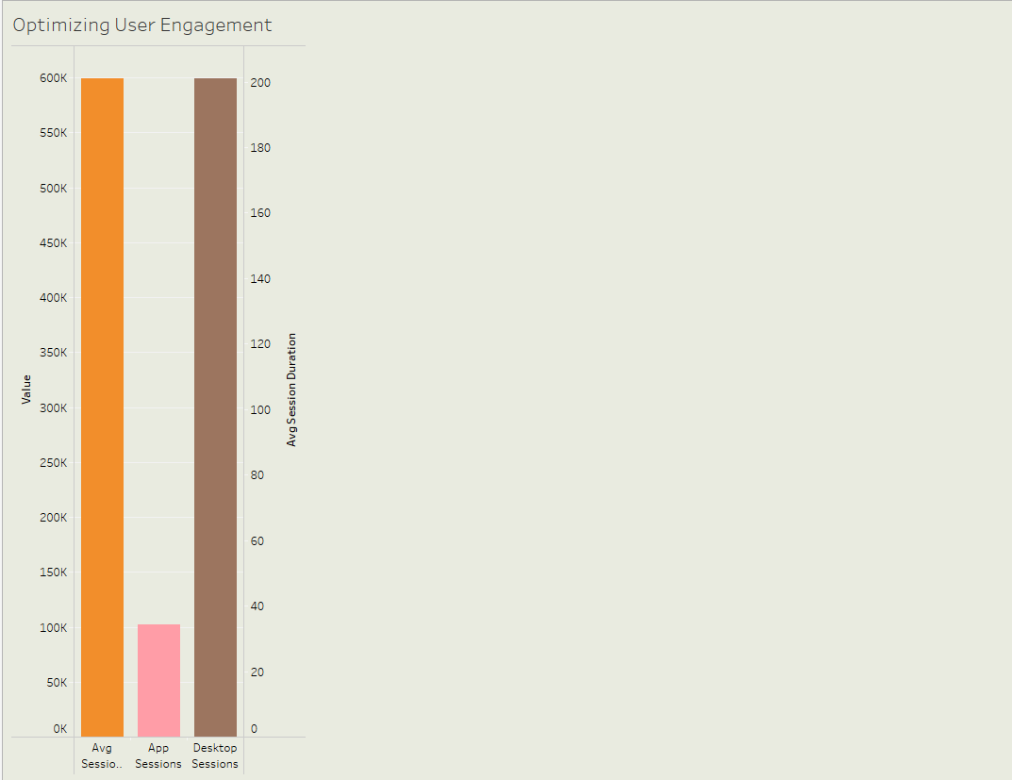

Slide 10
Session Insights

Slide 11
User Engagement Analysis
User Sessions Display: To understand the level of user engagement, our first point of focus is the total number of user sessions. The bar chart below provides a straightforward depiction of how many sessions our platform or service has experienced within a specified timeframe. This metric serves as an initial overview of user interaction..
Trends Visualization: Beyond the aggregate numbers, we delve into the trends shaping user engagement. The line chart showcases these trends over time, allowing us to identify periods of heightened or reduced activity. Understanding the ebb and flow of user engagement is crucial for devising strategies that align with user behavior.
Duration Patterns: Session duration is a key metric influencing user experience. In this section, we explore patterns in session duration, seeking to answer a fundamental question: Do longer sessions correlate with lower churn rates? By analyzing the relationship between session length and churn, we gain insights into the optimal duration for user interactions.
As we interpret these visualizations, we aim to uncover actionable insights. Are there specific timeframes with consistently high engagement? Do longer sessions indeed correspond to a lower likelihood of churn? These answers guide our approach to optimizing user engagement and, consequently, reducing churn.

Slide 12
Transaction Completion
“Business opportunities are like buses. There's always another one coming.”

Slide 13
Transaction Completion Analysis
Comparison Display: Effective transactions are a critical aspect of user engagement, and understanding completion rates provides insights into user satisfaction. The grouped bar chart below compares App Transactions and Desktop Transactions, shedding light on transaction completion across different platforms. This visual aid serves as a foundational element in comprehending user interactions.
Rate Visualization: Beyond the platform-based comparison, our focus narrows down to visualizing transaction completion rates for each segment. The visualization technique chosen, such as a bar chart or other graphical representation, facilitates a clear understanding of how successfully users are completing transactions. We delve into trends and correlations, identifying patterns that contribute to actionable insights.
As we interpret these visualizations, we seek answers to pivotal questions. Are there notable disparities in completion rates between app and desktop users? Do certain segments exhibit consistently higher transaction success? By uncovering these patterns, we refine our approach to transaction optimization and user satisfaction.

Slide 15
Churn Recovery Strategies
“Business opportunities are like buses. There's always another one coming.”

Slide 16
Churn Recovery Strategies
Re-Engagement Emphasis: One of the key pillars in mitigating churn involves effective re-engagement campaigns. In this slide, we delve into the significance of re-engagement strategies, emphasizing their role in reclaiming customers who have previously churned. Successful re-engagement not only retains customers but also contributes to long-term loyalty and revenue.
Success Showcase: Numbers speak volumes, and our past re-engagement efforts have been remarkably successful. The bar chart below illustrates the percentage of customers successfully re-engaged compared to the total churned customers. This success metric not only validates the effectiveness of our strategies but also provides insights into areas for further improvement.
Customer Support Impact: In tandem with re-engagement, improvements in customer support play a pivotal role in retaining customers. This section highlights positive changes in customer support and their direct impact on customer retention. Testimonials, feedback, or metrics reflecting improved customer satisfaction can be showcased to underline the positive outcomes of enhanced support initiatives.
As we explore these strategies, our goal is to not only recover churned customers but to foster stronger relationships that withstand potential future challenges.

Slide 17
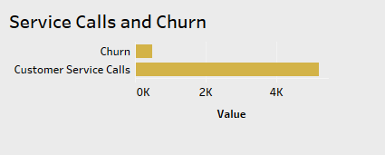

Slide 18
Retention Incentives
“Business opportunities are like buses. There's always another one coming.”

Slide 19
Retention Incentives Impact
Visual Impact: The implementation of retention incentives has a tangible impact on customer retention. The bar chart below visually represents the effectiveness of these incentives, showcasing the number of customers retained through incentive programs. This not only quantifies success but also provides a clear snapshot of the positive outcomes of our retention strategies.
Positive Representation: Incentives create positive customer experiences, fostering a sense of value and loyalty. The use of icons or images can effectively represent these positive experiences. Whether it's discounts, exclusive offers, or personalized rewards, these visual elements help convey the benefits that customers associate with our incentive programs.
Success Stories: Beyond numbers, success stories add a human touch to the impact of retention incentives. Share specific stories of customers who, thanks to our incentive programs, not only chose to stay but also became advocates for our brand. These narratives serve as powerful testimonials to the success and effectiveness of our retention strategies.
As we navigate the impact of retention incentives, these visual representations and success stories collectively contribute to a compelling narrative of our commitment to customer satisfaction and loyalty.

Slide 20
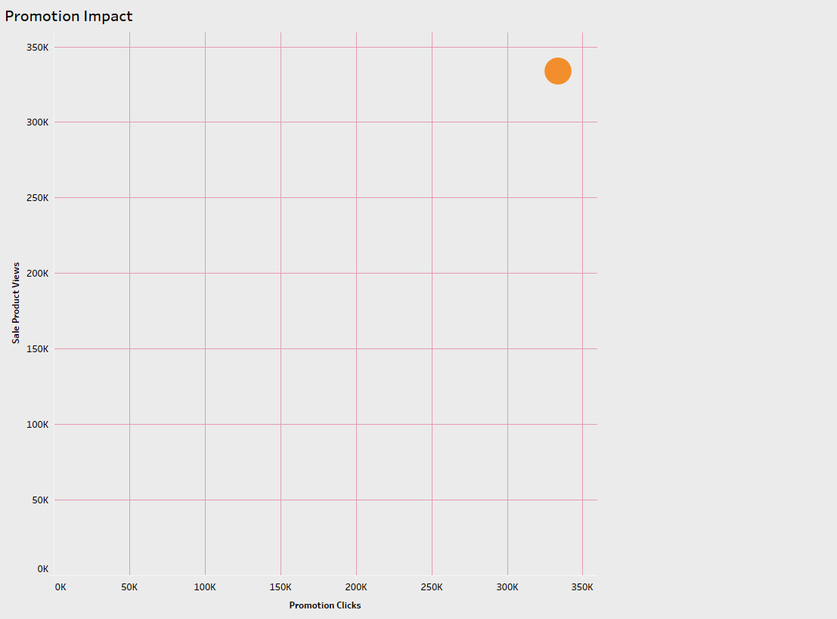

Slide 21
Loss Mitigation
“Business opportunities are like buses. There's always another one coming.”

Slide 22
Loss Mitigation - Revenue Impact
Revenue Loss Calculation: One of the critical aspects of our churn mitigation strategy is understanding the potential revenue loss. We calculate this by multiplying the churn rate by the average revenue per customer. This formula gives us a clear estimation of the financial impact of churn and underscores the importance of taking proactive measures to mitigate losses.
Visual Representation: To provide a visual understanding of the potential revenue loss, we use a dynamic KPI or a bar chart. This visualization serves as a powerful tool for stakeholders to grasp the magnitude of the financial impact. It also acts as a driving force behind the urgency to implement effective churn reduction strategies.
As we delve into loss mitigation, these visual elements not only convey the numerical impact but also emphasize the need for strategic interventions to protect our revenue streams and sustain financial health.

Slide 23
Actionable Insights
“Business opportunities are like buses. There's always another one coming.”

Slide 24
Actionable Insights
Session Analysis Summary: In our thorough session analysis, we've uncovered crucial insights about sessions prone to churn. By using tooltips or annotations, we've highlighted specific patterns and behaviors that indicate a higher likelihood of customer churn. Understanding these nuances allows us to tailor our strategies to address and optimize these critical touchpoints.
Segment Analysis Overview: Our exploration into different segments has revealed valuable information about those with the highest loss potential. This segment-focused approach enables us to prioritize our efforts and resources towards retaining customers in these specific categories. A summarized overview sheds light on where our attention is most needed for effective churn mitigation.
Recommendations: Armed with these insights, we present actionable recommendations to guide our strategies for churn recovery. Whether it's optimizing user experiences during critical sessions or implementing targeted campaigns, these recommendations are grounded in data and poised to make a tangible impact on customer retention.

Slide 25
Conclusion
“Business opportunities are like buses. There's always another one coming.”

Slide 26
Engage, Adapt, Succeed
Reinforcement: As we conclude our exploration into churn recovery and loss mitigation, it's crucial to reinforce the paramount importance of these efforts. Minimizing churn is not just a reactive measure but a proactive strategy for the sustained health and growth of our business. By addressing customer attrition head-on, we pave the way for enhanced customer satisfaction, loyalty, and financial stability.
Collaboration Encouragement: Success in churn recovery requires a collaborative effort across departments and functions. I encourage each team member to actively engage in cross-functional collaboration. By bringing together diverse perspectives and skill sets, we can implement strategies that resonate with our customers and yield the desired results.
Closing Note: In closing, let's remember that the insights gathered from this dashboard are not just numbers; they represent opportunities for positive change. The call to action is clear — let's leverage these insights to implement effective strategies, optimize customer experiences, and fortify our position in the market.

Slide 27
A heartfelt thank you to everyone who contributed to making this possible!
By- Pawar Mahendra
Storyboard Visuals Link Please click here

