Slide 1
Capstone Project
Personal Loan Modeling
By Lim Lee Huat (567J)

Slide 2
Problem Statement
Thera Bank’s Management wants to explore ways of converting its liability customers to personal loan customers (while retaining them as depositors).
A campaign that the bank ran last year for liability customers showed a healthy conversion rate of over 9% success. This has encouraged the retail marketing department to devise campaigns with better target marketing to increase the success ratio with minimal budget.
This Analysis derive which customer profile is more likely to accept the personal loan offer and devise strategy based on it.

Slide 3
DataSets
Derived :https://www.kaggle.com/datasets/teertha/personal-loan-modeling
Total : 14 columns as follows:

Slide 4
Datasets : Reclassify to Dimension
Change column Education from 1,2,3= Undergrad, Graduate, Advance/Professional
Change Column Personal Loan, Securities Account, CD Account, Online, Credit Card
from 0 = No, 1=Yes

Slide 5
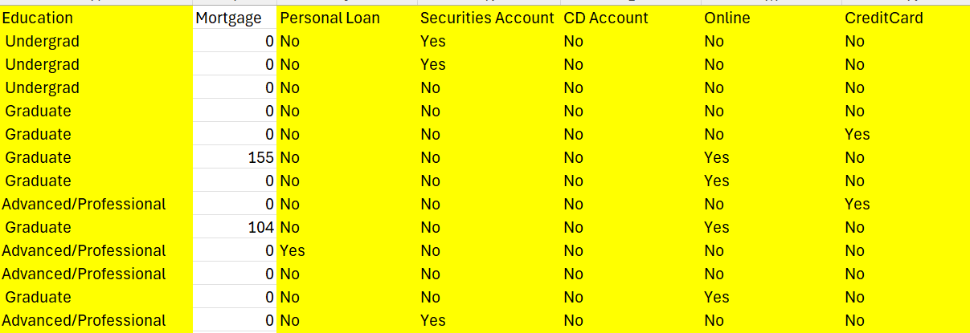
Datasets : Reclassify to Dimension
Before
After
Name : 0 = No, 1= Yes
Education Level: 1= Undergrad, 2=Graduate. 3=Advance/Professional

Slide 6
Datasets : Not Affecting Personal Loan
Zip code, Online and Credit card ownership unlikely to have an impact on the personal loan outcome
This 3 Sets of data will not be analyzed.

Slide 7
Tableau Storyboard:
Age group taking up personal loan
Education Level taking up personal loan
Income affect the personal loan conversion
Avg. spending on credit cards per month ($000) taking up personal loan
Family size taking up the personal loan
Years of working experience taking up personal loan
Mortgage trend taking up personal loan
Securities Deposit and Certificate of Deposit account impact on loan taking
7

Slide 8
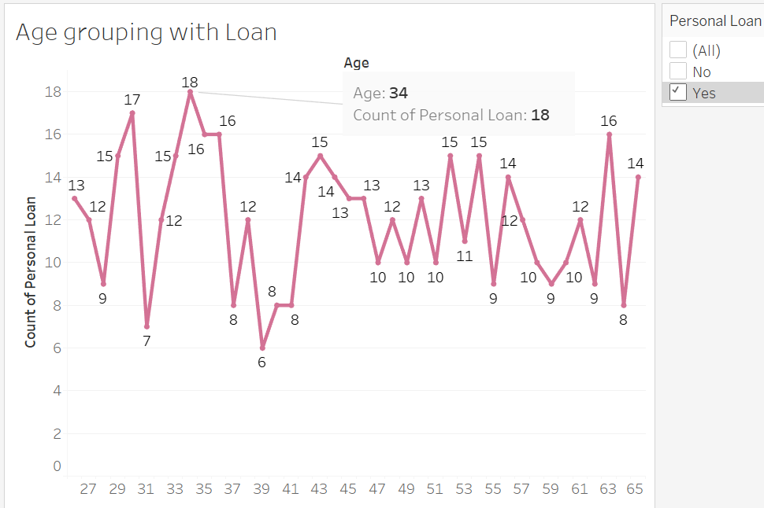
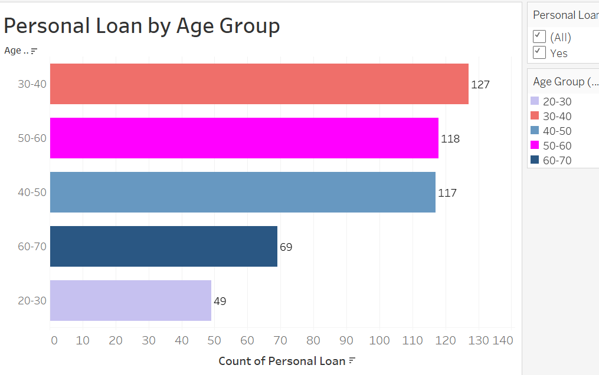
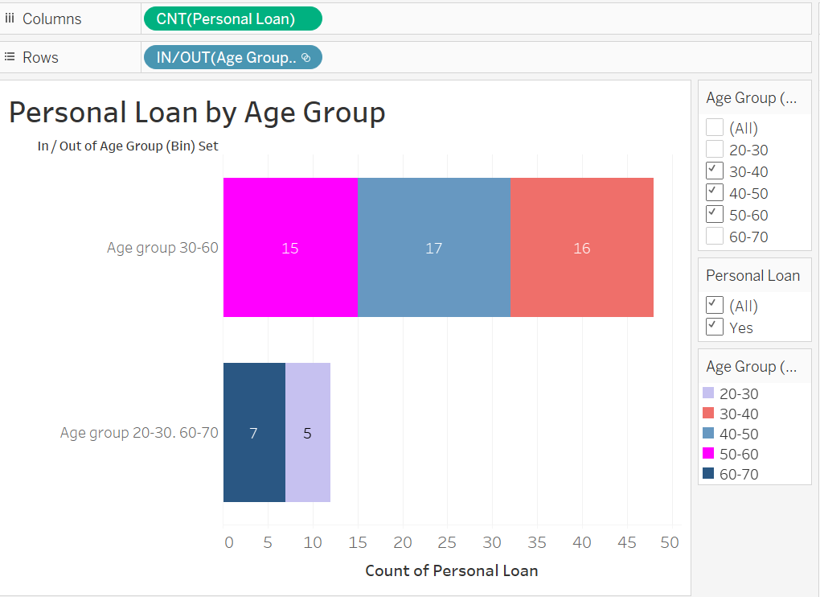
Storyboard: Age group
Total 480 customers Age range from 26 to 65 years old took up Loan
Age 34 taken up most loan , Age 39 taken up the least loan.
Grouping into Age 20-30, 30-40, 40-50,50-60,60-70
Age group 30-40 taken up most loan
Both Age group 50-60 and 40-50 (Highest)
to take up the most loan
Age group 30-60 take up the most loan
Age group 20-30 and 60-70, are the least to take up loan
https://public.tableau.com/app/profile/lim.lee.huat/viz/PersonalLoan_LimLeeHuat-567J/AgegroupingwithLoan?publis

Slide 9
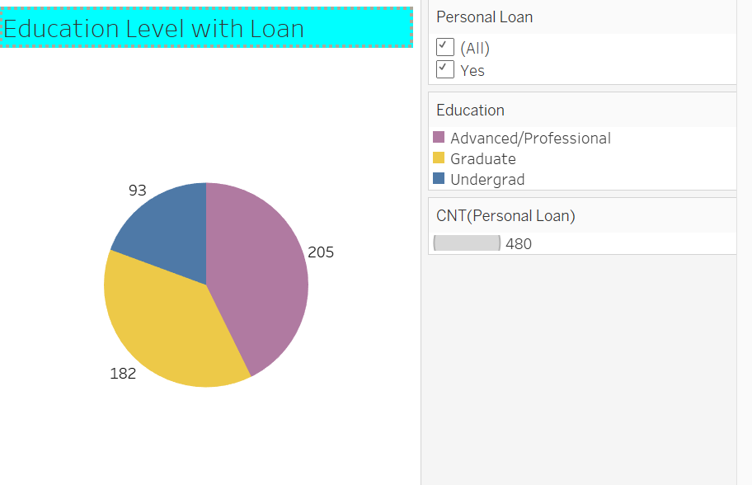
Storyboard-Education level
Advanced/Professional taken up the most loan
Follow by graduate and Undergraduate
https://public.tableau.com/app/profile/lim.lee.huat/viz/PersonalLoan_LimLeeHuat-567J/EducationLevelwithLoan?publi

Slide 10
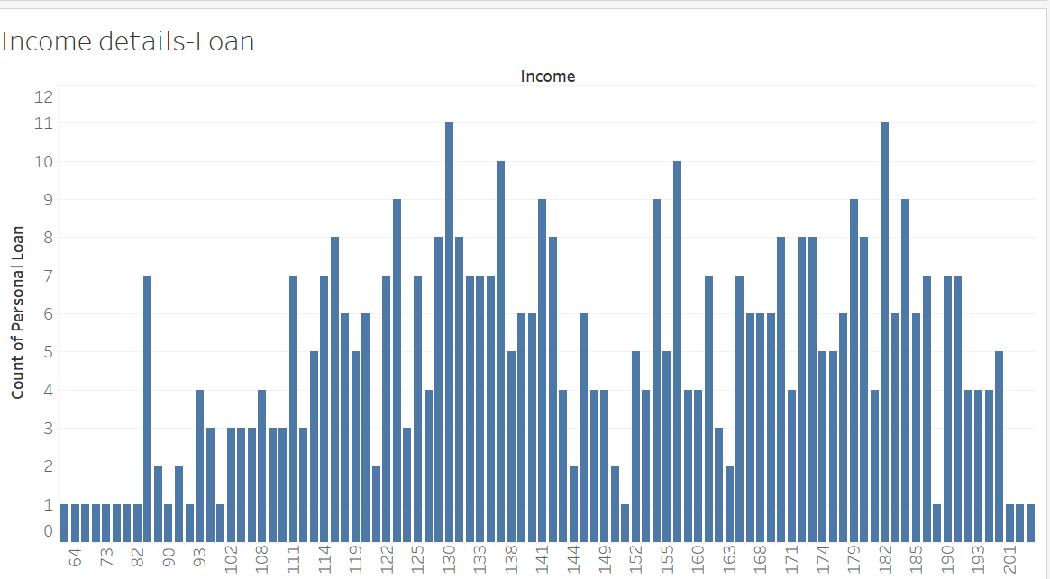
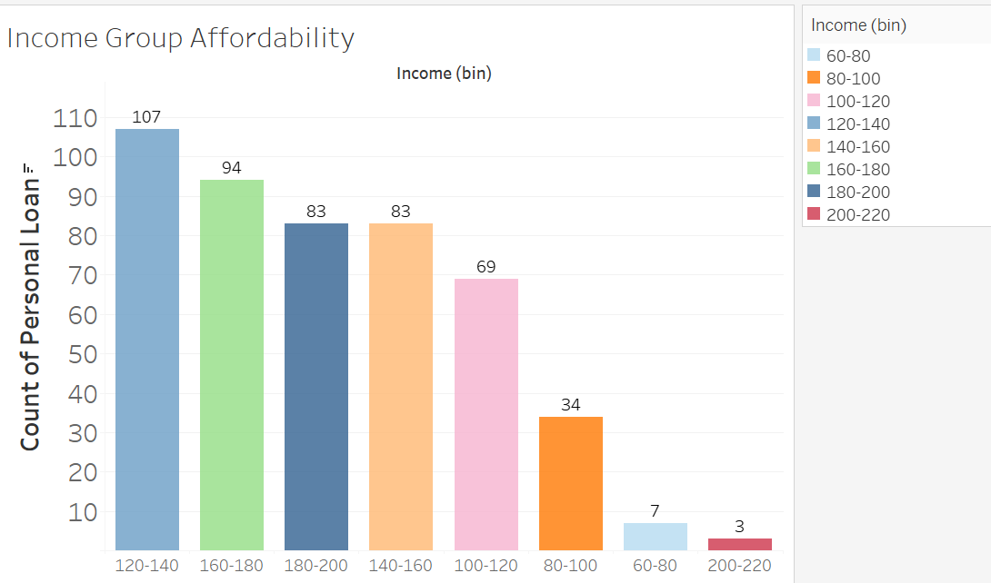
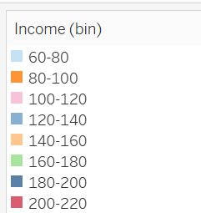
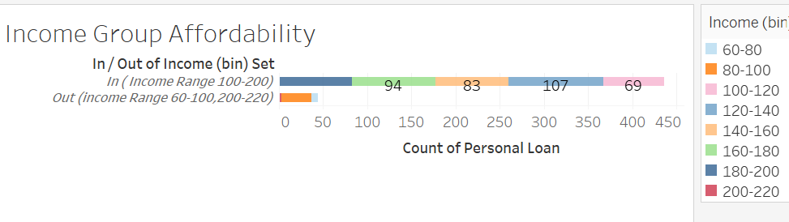
Storyboard- Income Level
Income Level Range from 60-203 ($000)
Group into 8 groups:
Income Range from 100-200 take up most loan
Income Range from 60-100,200-220 take up the least loan
https://public.tableau.com/app//lim.lee.huat/viz/PersonalLoan_LimLeeHuat-567J/IncomeGroupAffordability?publish=yes

Slide 11
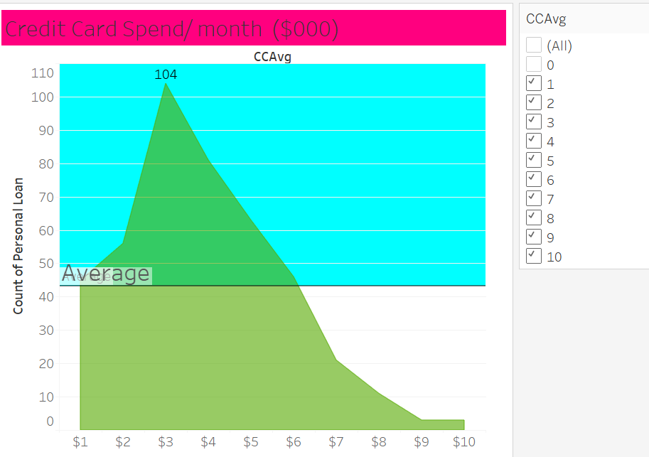
Storyboard-Ave spending on credit card per month taking loan
Ave Spending on credit card $3000/month taken up most loan
Ave Spending on credit card 9000-10,000 /month taken up the least loan
Average loan taken up 43.3 range on credit card spend from 1000-6000.
https://public.tableau.com/app/profile/lim.lee.huat/viz/PersonalLoan_LimLeeHuat-567J/CreditCardSpend?publish=yes

Slide 12
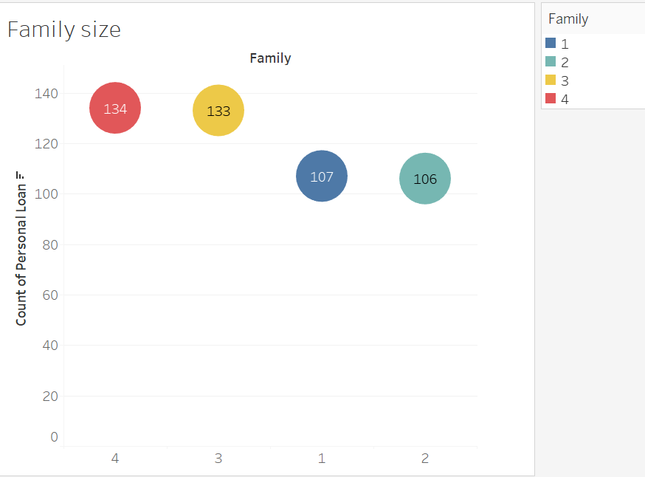
Storyboard-Family Size taken up the loan
Family Size 3 and 4 taken up most loan
Family Size 1 and 2 taken up less loan
Top is family size 4 follows by 3, 2 and 1
https://public.tableau.com/app/profile/lim.lee.huat/viz/PersonalLoan_LimLeeHuat-567J/Familysize?publish=yes

Slide 13
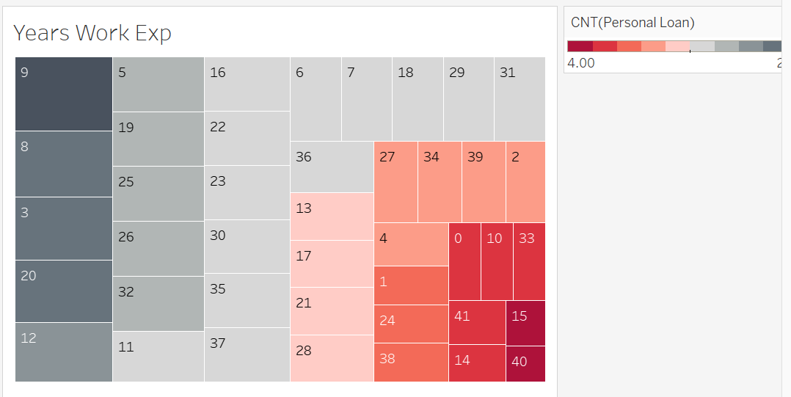
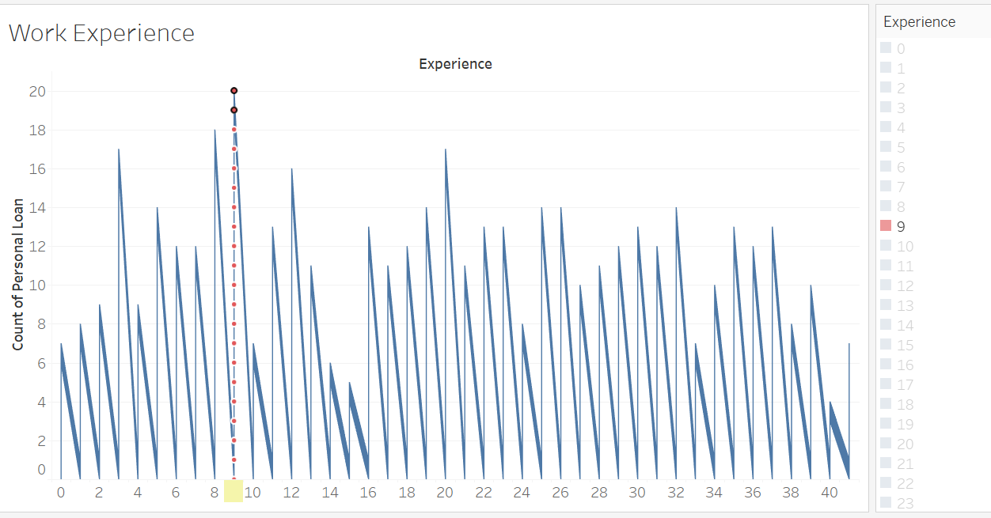
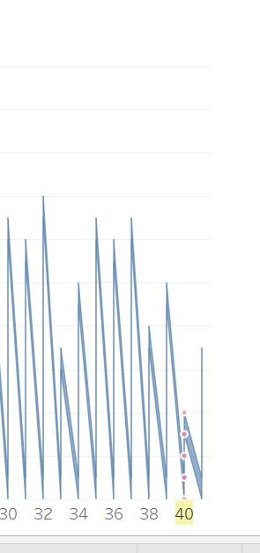
Storyboard-Years of working experience taking up Loan
Total loan taken up 20-16 case from 9,8, 3,20 and 12 years experience
Total loan taken up 14 case from working experience 5,19, 25,26 and 32 years.
Total case taken up 12-13 from working experience 11, 16, 22, 23,30,35, 37,6.7,18,19, 31 and 26 years.
Total taken up case 11 from working experience 13, 17, 21 and 28 years
Total taken up case 10 from 34, 39, 2 and 4 years.
Total taken up case 8 from 1, 24 and 38 years working experience
Total taken up case 6 and 7 from 0,10, 33, 41 and 14. years
Total taken up case 5 from 15 and 40 working experience
Working experience 9 years top with most loan
Working experience 40 years least to take loan
https://public.tableau.com/app/profile/lim.lee.huat/viz/PersonalLoan_LimLeeHuat-567J/YearsWorkExp?publish=yes

Slide 14
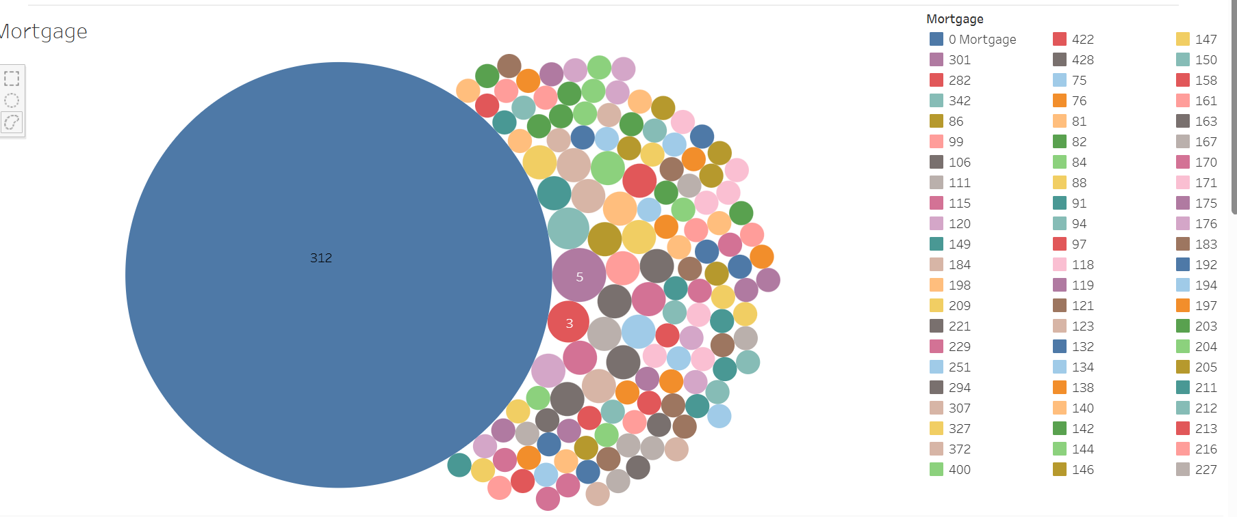
Storyboard- Mortgage Trend taking up Loan
0 Mortgage spearhead with 312 loan cases
Follow by 301 Mortgage with 5 case, and 282 Mortgage with 3 case
ttps://public.tableau.com/app/profile/lim.lee.huat/viz/PersonalLoan_LimLeeHuat-567J/Mortgage?publish=yes

Slide 15
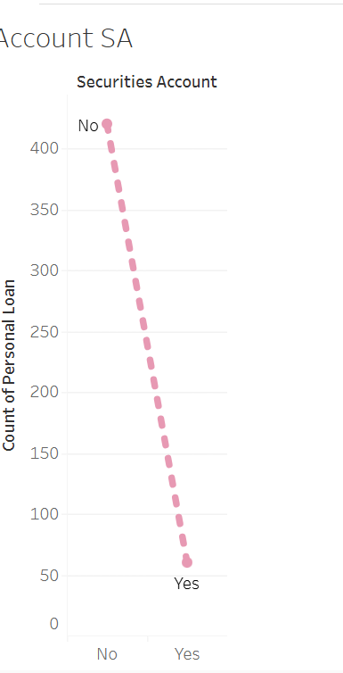
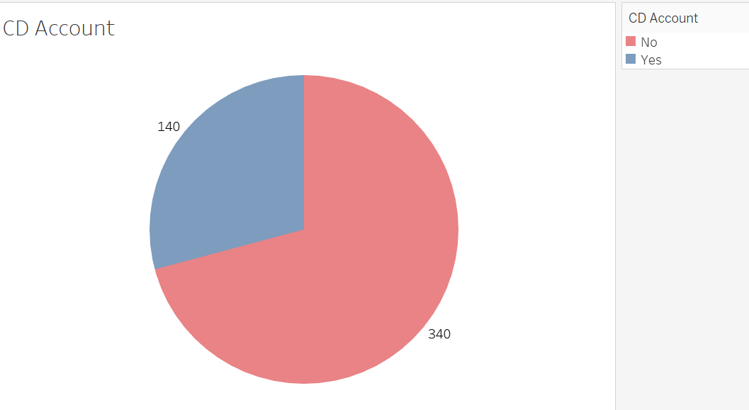
Storyboard-Account SD and Certificate of Deposit account impact on loan
420 ppl taking up loan are without Account SD compare to 60 with Account of SD
Customer without CD account take up the most loan
https://public.tableau.com/app/profile/lim.lee.huat/viz/PersonalLoan_LimLeeHuat-567J/AccountSA?publish=yes
https://public.tableau.com/app/profile/lim.lee.huat/viz/PersonalLoan_LimLeeHuat-567J/CDAccount?publish=yes

Slide 16
Findings:
Age Group:
Age 34 taken up most loan, Age 39 taken up least loan.
Grouping : 20-30, 30-40, 40-50,50-60,60-70,
Age group 30-40 taken up most loan, range 30 -60 highest to take loan
Age group 30-60 taken up most loan, 20-30 and 60-70 least to take up loan
Education Level:
Advanced/Professional, follow by graduate and Undergraduate taken up loan
Income Level:
Income Level Range from 60-203 ($000)
Income level 100-200 ($000) taken up most loan, income level 60-100,200-220 take up least loan
Ave spending on credit card per month ($000)
$3,000 spending taken up most of the loan, least from spending 9,000-10,000,
Ave spending from1000-6000 taking the loan.

Slide 17
Findings:
Family Size:
Size of 3 and 4 taken up most of the loan. Follow by Size 1 and 2.
Mode Sequence : 4, 3, 2, 1 size members.
Years of working experience taking up the loan
Working experience 9 years top with most loan of 20 case
Working experience 40 years least to take loan of 3 case.
With working experience range from 0-41 years, there is no significant trend on behavior link to loan
Mortgage
Customer with 0 mortgage loan will take up loan case as it reflected 312 case taken up loan upon no mortgage
Account SD and Certificate of Deposit impact on loan
    Customer with no account of Securities Deposit and no certificate of deposit likely hood to take up loan

Slide 18
Recommendations
Focus on Key contribution factors (Fixed/Variable)
  Fixed (short-mid term): Age group, Education Level, Family size, income level,
  Variable (any time) : Ave spending on credit card
Target on :
Age group : 30-40, 40-50,50-60
Education Level: Advance/Professional follow by Graduate
Roadshow on weekday to capture this working group class , Premises in Central Business District and Town area
Dress smart and casual to capture the attention of working class age group of 30-50.
Family Size: 4 and 3
Size of 4 and 3 usually are married couples with children .
Introduce personal loan for education funding, as the age group is around 30-50. Young parents with children still in school.
Children could be in University. Promote education loan, College/Secondary and Primary school, introduce endowment plan.

Slide 19
Recommendations
Income Level: 100-200 ($000) annual taken up most loan
Promote the loan plan per month {minimum) : Annual income/12 X 1%=less then 200
Ave spending on credit card per month ($000)
$3,000 spending taken up most of the loan, Ave spending from1,000-6,000
Promote Freebies upon signing up. Shopping voucher of 200 upon signing up a new loan plan

Slide 20
End of Presentation
Thank you!
Done by Lim Lee Huat {567J}

